Slide 1


A world where people matter – powered by tech
6 DECEMBER 2022
Pion Group Q3 2022
Rörelsemarginal
5,9 (-1,6) %

Slide 2

A world where people matter – powered by tech
Some basic facts
Listed on Nasdaq Stockholm, Small Cap
47,1 million shares
3 514 employees

Slide 3

A world where people matter – powered by tech
What we do
PION Group owns, develops and acquires companies focusing on people.
By adding tech we generate insights that will accelerate individual, business and organizational growth.

Slide 4

Vision
A world where people matter
- powered by tech

Slide 5

A world where people matter – powered by tech
Management strategy
All work within PION Group also capitalizes on the group's well-proven methodology that has built countless fast-growing businesses. The platform is based on four components
- Entrepreneurship
- Specialisation
- Sales culture
- Best people

Slide 6
A world where people matter – powered by tech
Areas of expertise
Consulting in, among other things, IT, Tech and Strategy
Interim Management
Executive Search
HR-Tech
Recruiting
Staffing
Geography
Sweden
Finland
Norway

Slide 7
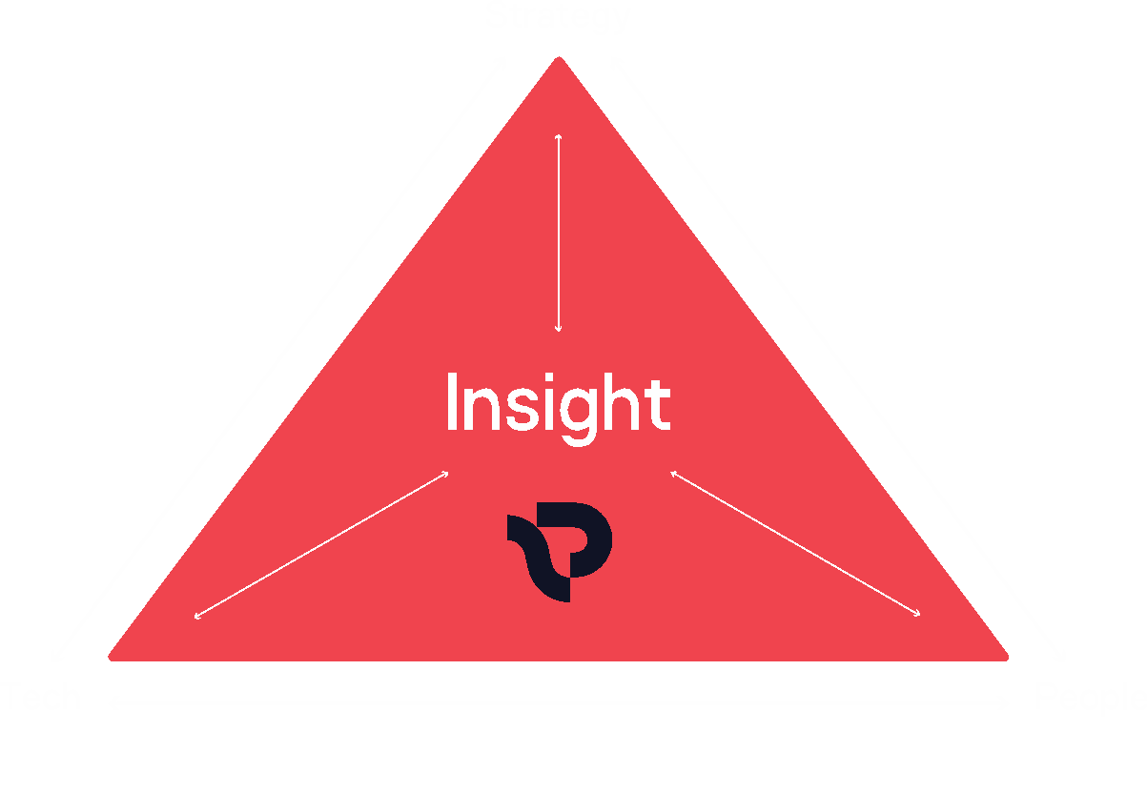

A world where people matter – powered by tech
People, Strategy & Tech the foundation for Insight

Slide 8



A world where people matter – powered by tech
Acquisition of Dreamwork (3/1 – 2023)
Sales 2022 160 MSEK
EBIT 2022 almost 5%
”Innovative expertise in digitization”

Slide 9






A world where people matter – powered by tech
PEOPLE
Consulting within IT, Tech, Life-Science and Engineering
Recruitment and Staffing within Finance, Office, Light Tech as well as Interim Management and Executive Search
Staffing and Recruitment for the industrial-, warehouse- and customer service sector
TECH
Digital recruitment-platform
Digital and IRL jobfairs and jobevents for students
STRATEGY
QRIOS Minds Insights AB. Management Consulting, mainly within the Talent- and HR sector

Slide 10
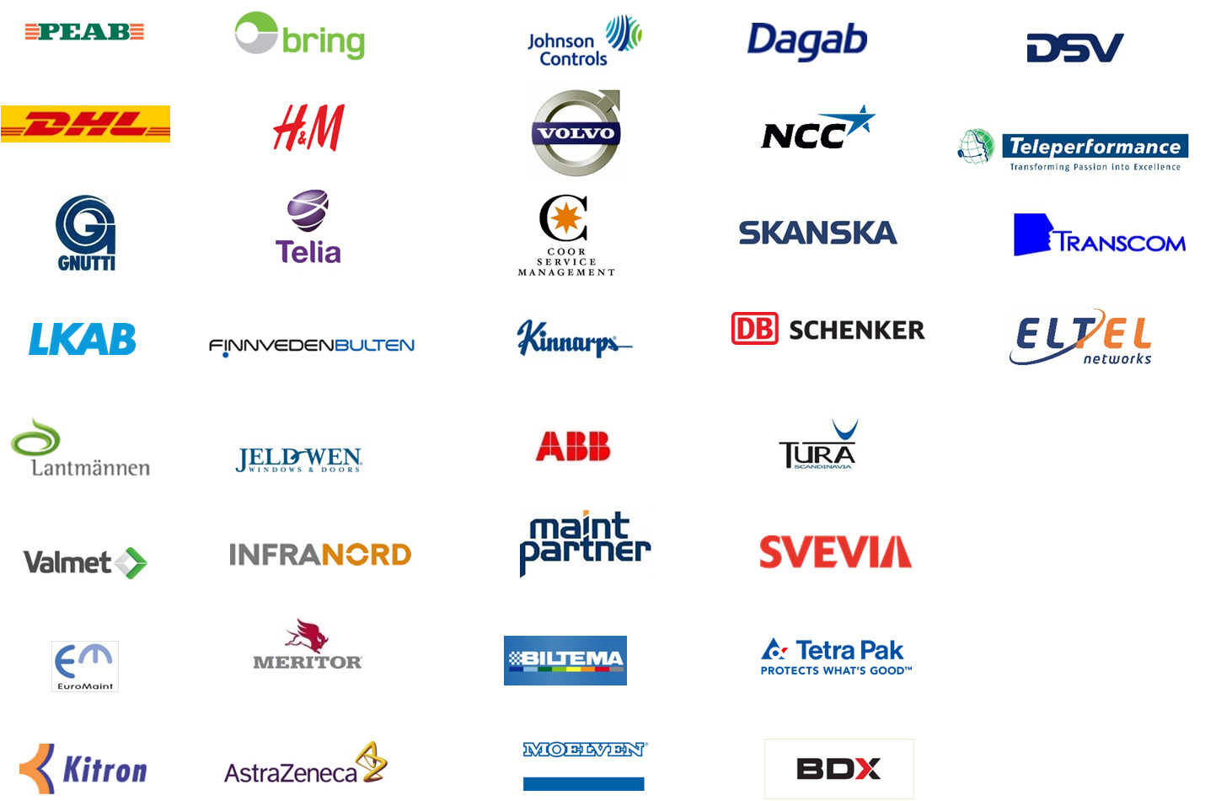
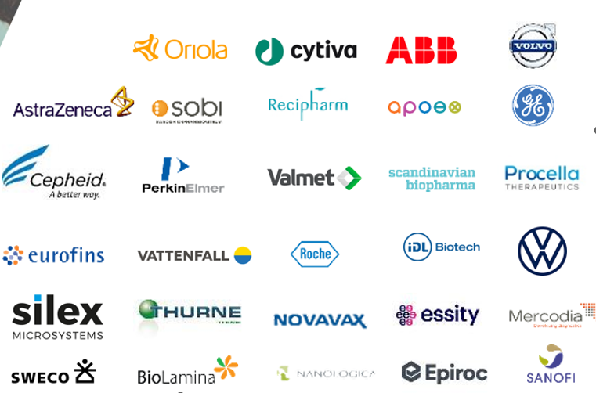

A world where people matter – powered by tech
Proven track record with proud list of clients

Slide 11
A world where people matter – powered by tech
Sales and Profit
PION Group Q3 2022
Sales
511 (445) MSEK
EBITA
22,7 (25,9) MSEK
EBITA margin
4,4 (5,8) %
PION Group Sales was up 15% from 445 MSEK in Q3 2021
PION Group EBITA Q3 2021 was 25,9 MSEK. Down 3,2 MSEK due to investments in staff and brands as well as tougher competition for Uniflex
PION Group EBITA margin

Slide 12
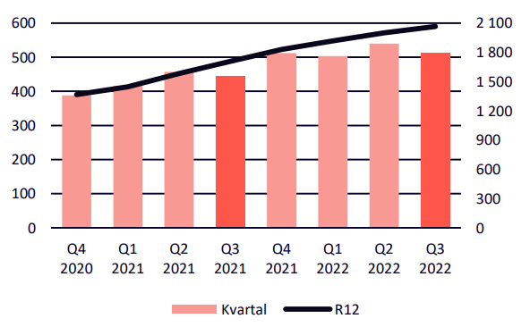
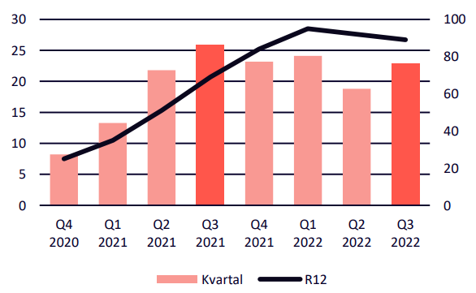
A world where people matter – powered by tech
Sales and Profit
Group sales, MSEK
People, Strategy & Tech
QRIOS & brands* - Q3 2022
Sales in QRIOS was 53 (44) MSEK, +21%
EBITA in QRIOS was 1,4 (3,5) MSEK and EBITA margin was 2,7 (7,9) %
People
Poolia - Q3 2022
Quarter
Sales in Poolia was 148 (117) MSEK, +26%
EBITA in Poolia was 6,4 (6,4) MSEK and EBITA margin was 4,3 (5,5) %
Group EBITA, MSEK
People
Uniflex - Q3 2022
Sales in Uniflex was 309 (284) MSEK, +9%
EBITA in Uniflex was 12,8 (15,8) MSEK and EBITA
margin was 4,1 (5,6) %
Quarter
*QRIOS includes brands QRIOS Minds, QRIOS Life Science, QRIOS Engineering, QRIOS IT, QRIOS Technology, Workspace Recruit, ROI Rekrytering, Student Node

Slide 13
A world where people matter – powered by tech
New financial targets
Growth
Annual total growth of at least 20% including both organic growth and acquisition
Margin
EBITA-margin of 5% or higher
Net Debt Ratio
Interest-bearing liabilities of a max 2x EBITA depending on attractive acquisitions
Dividend
The priority in the coming year is to create value growth for shareholders by self-financing growth

Slide 14

A world where people matter – powered by tech
The journey
2000 MSEK - 4000 MSEK 2026
20% growth per year:
Organic growth: 10%
Acquisition: 5%
New business areas and models: 5%
5% EBITA margin on group level

Slide 15

A world where people matter – powered by tech
Thanks for listening
jan.bengtsson@piongroup.se
Phone 073 600 68 10

